Slide 1
The Rady School of Management
Lecture #6,
January 27, 2020
Wrap up – Consumer Marketing - Coppertone
Organizations as Customers
MGT 103
Winter 2020
M,W 11:00a to 12:20p

Slide 2

COPPERTONE: CREATING THE LEADING SUN CARE BRAND BY UNDERSTANDING CONSUMERS
Coppertone Video Case

Slide 3
VIDEO CASE Coppertone
How understanding consumer behavior helped Coppertone grow in the United States and around the globe?
Describe the five-stage purchase decision process for a Coppertone customer.
What are the possible situational, psychological, and sociocultural influences on the Coppertone consumer purchase decision process?
What challenges does Coppertone face in the future? What actions would you recommend related to each challenge?

Slide 4
The Rady School of Management
Lecture #6,
January 27, 2020
Organizations as Customers
MGT 103
Winter 2020
M,W 11:00a to 12:20p

Slide 5
Key Talking Points….Organizational Buying
Distinguish among industrial, reseller, and government organizational markets.
Key characteristics of organizational buying that make it different from consumer buying.
Explain how buying centers and buying situations influence organizational purchasing.
Recognize the importance and nature of online buying in industrial, reseller, and government organizational markets.

Slide 6

ORGANIZATIONAL BUYING IS MARKETING, TOO! PURCHASING PUBLICATION PAPER FOR JCPENNEY
JCPMedia:
Buys 100,000+ Tons of Paper per Year for Newspaper Inserts and Direct Mail
10 Companies Around the World Supply the Paper
Sizable Revenue and Expense
JCPenney
Website
Courtesy of JCPenney

Slide 7

BUSINESS-TO-BUSINESS MARKETING AND ORGANIZATIONAL BUYERS
Business-to-Business Marketing
Organizational Buyers
Industrial Markets (Industrial Firms)
Reseller Markets (Resellers)
Wholesalers
Retailers
Government Markets (Government Agencies)
NASA
Courtesy of Lockheed Martin Company

Slide 8
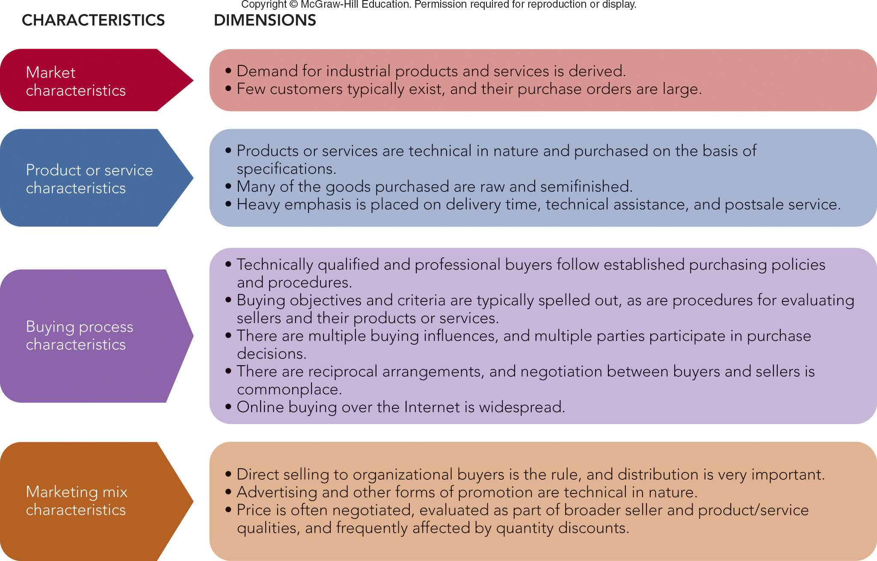
FIGURE 6-1 Key characteristics and dimensions of organizational buying behavior
Jump to Appendix 1 long image description

Slide 9

ORGANIZATIONAL BUYING DEMAND CHARACTERISTICS
Derived Demand
Size of Order or Purchase
Number of Potential Buyers
Organizational Buying Objectives
Profits
Women and Minority Suppliers and Vendors
Efficiency
Environment and Sustainability
©Karie Hamilton/Bloomberg via Getty Images

Slide 10
CHARACTERISTICS OF ORGANIZATIONAL BUYING ORGANIZATIONAL BUYING CRITERIA
Organizational Buying Criteria
Price
Ability to Meet Specs
Ability to Meet Schedules
Technical Capacity
Past Performance
Warranties
Production Capacity
Supplier Development

Slide 11
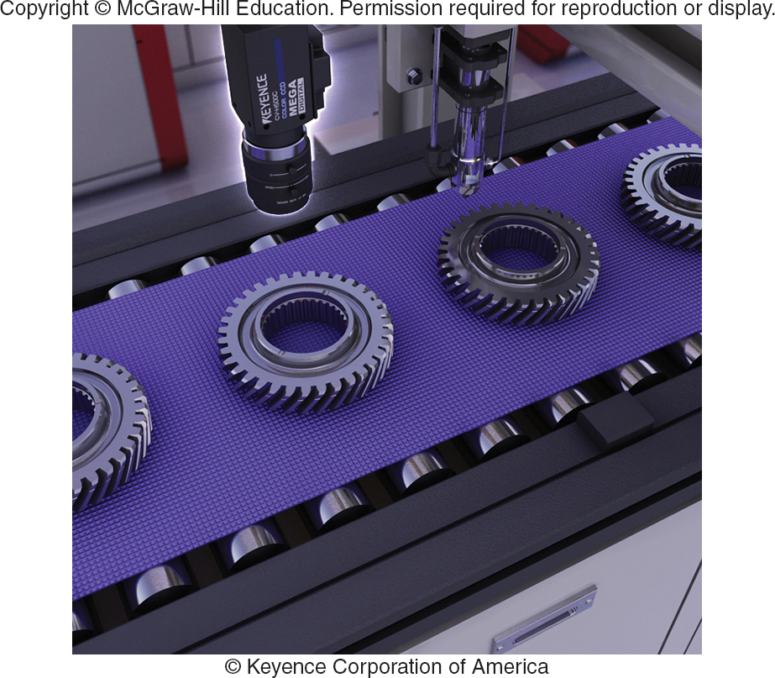
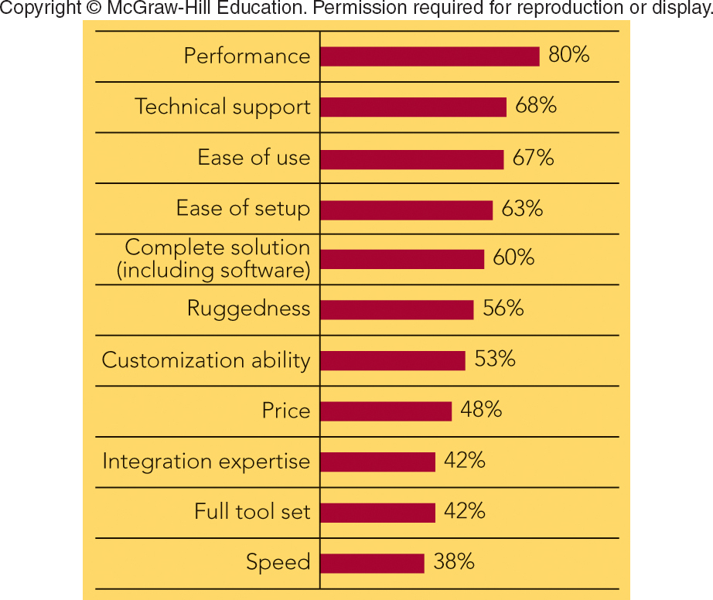
FIGURE 6-2 Product and supplier selection criteria for buying machine vision equipment emphasize factors other than price.
Machine vision inspection camera used in auto industry to perform a gear inspection
Percentage of machine vision buyers citing individual selection criteria as important when making supplier decision
Jump to Appendix 3 long image description
Photo: Courtesy of © Keyence Corporation of America

Slide 12
CHARACTERISTICS OF ORGANIZATIONAL BUYING BUYER-SELLER RELATIONSHIPS AND SUPPLY PARTNERSHIPS
Reciprocity
Supply Partnership
Sustainable Procurement
To Benefit the Environment

Slide 13

MARKETING MATTERS Milsco Manufacturing—Delivering a Great Ride for Customers’ Seats
Milsco Manufacturing:
3 Million Seats
200 Unique Variations
84-Year Partnership with Harley-Davidson
100 New Products perYear to Meet Customer Requirements
Milsco Website
.
©Lluis Gene/AFP/Getty Images

Slide 14
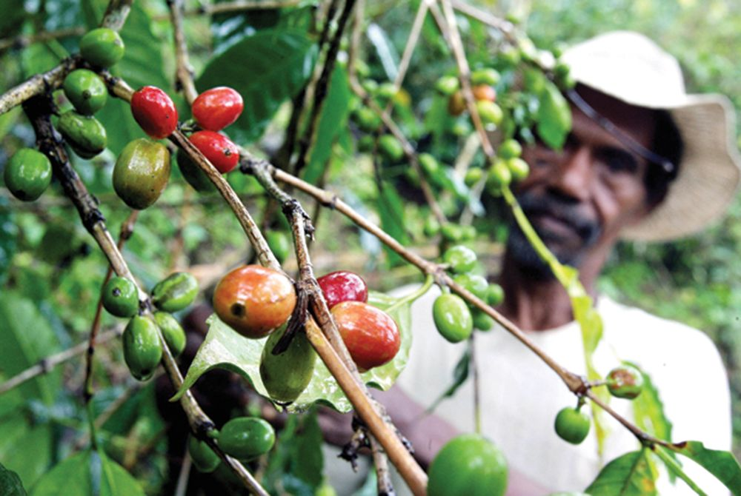
MAKING RESPONSIBLE DECISIONS Sustainable Procurement for Sustainable Growth
Starbucks Is a Leader in Sustainable Procurement:
Integrates Environmental Considerations into the Organization’s Buying Process
Coffee Growers in 20 Countries
Fair Price for Beans
Ecologically Sound Growing
Starbucks
Sustainability
©Jewel Samad/AFP/Getty Images

Slide 15
ORGANIZATIONAL BUYING FUNCTION AND PROCESS AND THE BUYING CENTER
Organizational Buying Behavior
Buying Function in Organization Responsible for:
Selection and Purchase of Products
For Organization’s Use or Resale
Formal Bids
Purchasing Contract Awards

Slide 16
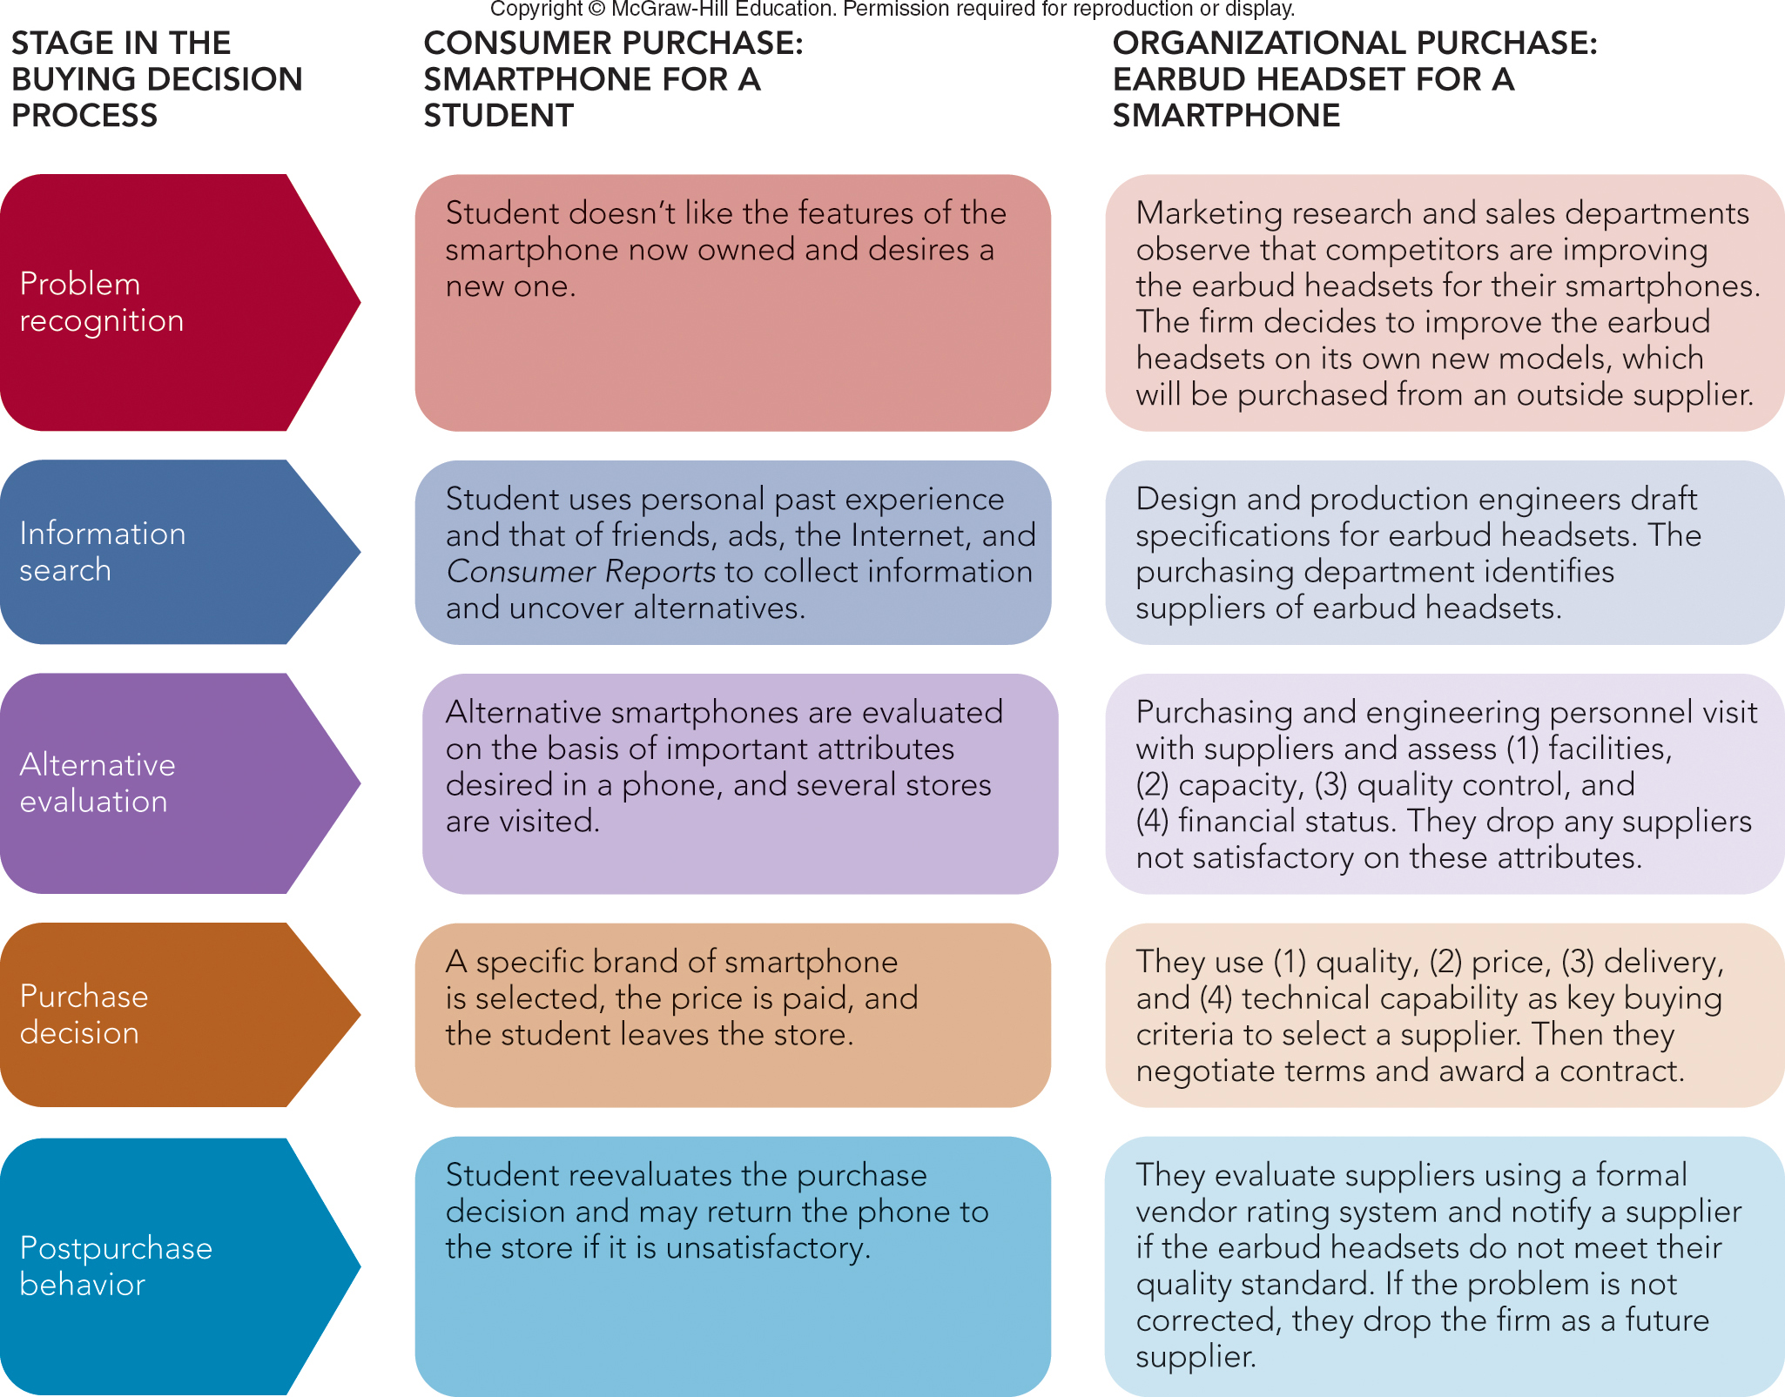
FIGURE 6-3 Comparing the stages in a consumer and organizational purchase decision process.
Jump to Appendix 4 long image description

Slide 17

ORGANIZATIONAL BUYING PROCESS AND THE BUYING CENTER
Buying Center
Buying Committee
People in the Buying Center
Roles in the Buying Center
Users
Influencers
Buyers
Deciders
Gatekeepers
©monkeybusinessimages/iStock/Getty Images

Slide 18
CHARACTERISTICS OF ORGANIZATIONAL BUYING THE BUYING CENTER
Number of People in Buying Center Depends on the Buying Situation
Buy Classes
New Rebuy
Straight Rebuy
Modified Rebuy

Slide 19
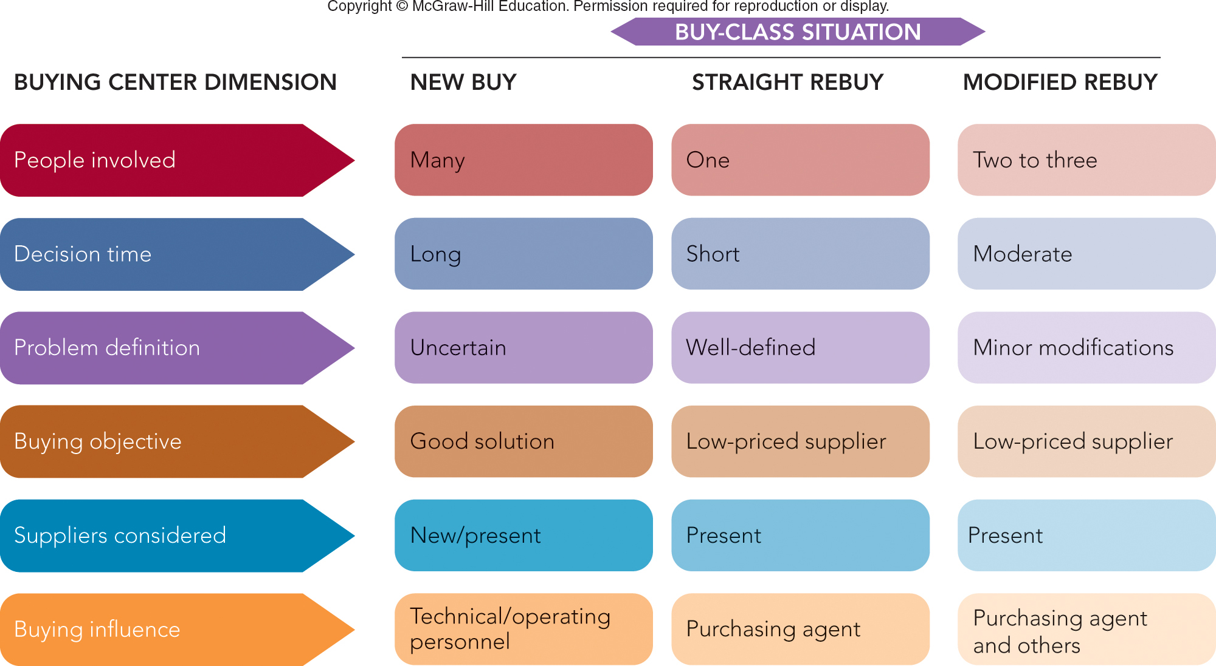
FIGURE 6-4 The buying situation affects buying center behavior in different ways.

Slide 20
ONLINE BUYING IN BUSINESS-TO-BUSINESS MARKETING
Prominence of Online Buying in Organizational Markets
Provides Timely Information
E-marketplaces
Online Auctions in Organizational Markets
Traditional Auction
Reverse Auction

Slide 21
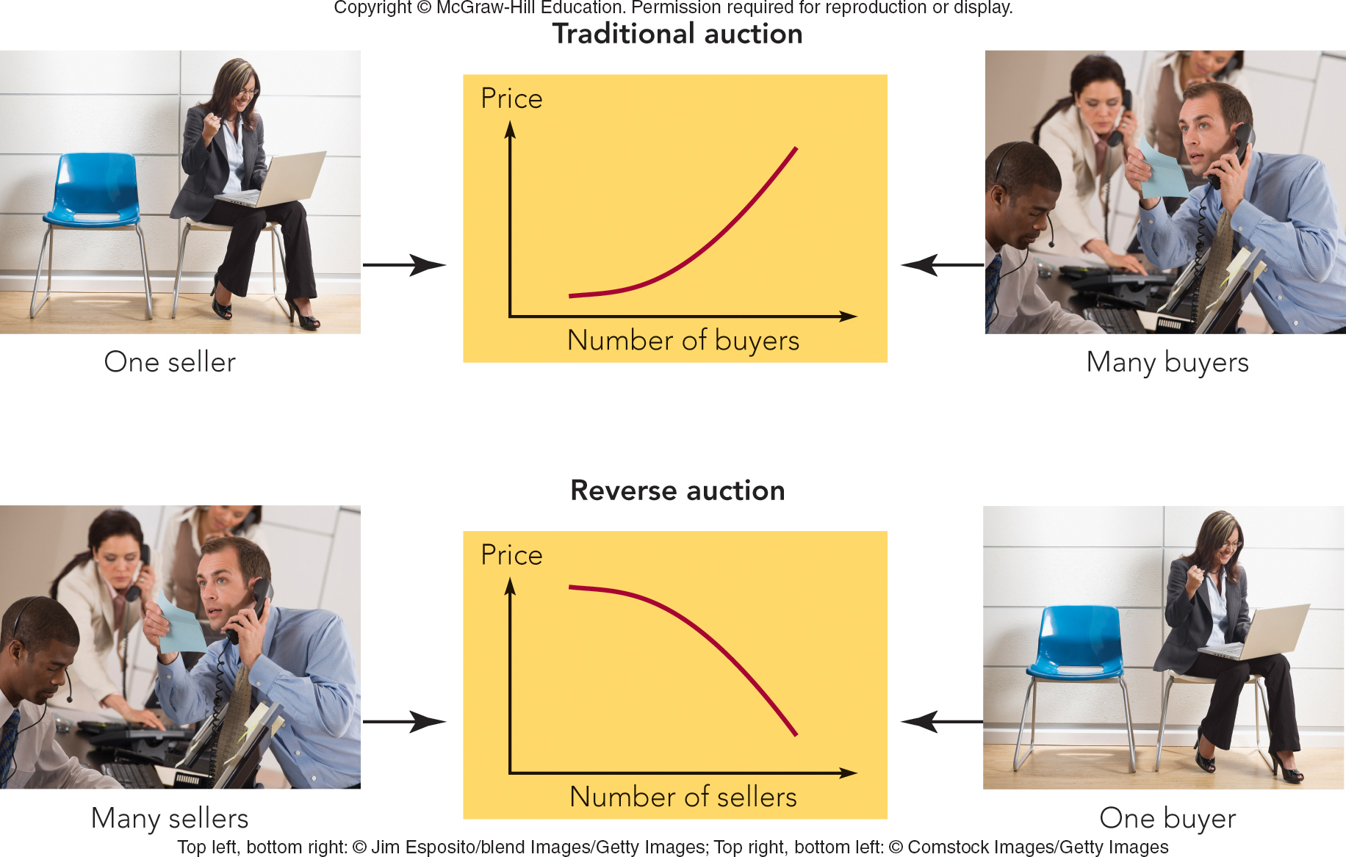
FIGURE 6-5 Buyer and seller participants and price behavior differ by type of online auction.

Slide 22

MARKETING MATTERS eBay Means Business for Entrepreneurs
Ebay Offers Trading Platform for Millions of Small Businesses
81 Percent of Small Businesses Sell to 5 or More Foreign Countries
82 Percent Report It Helped Business Grow
78 Percent Reduced Costs
79 Percent Became More Profitable
eBay Website
©Grzegorz Knec/Alamy Stock Photo

Slide 23
VIDEO CASE Key Points to Observe……
What is the role of the buying center at Trek? Who is likely to comprise the buying center in the decision to select a new supplier at Trek?
What selection criteria does Trek utilize when it selects a new supplier or evaluates an existing supplier?
How has Trek’s interest in the environmental impact of its business influenced its organizational buying process?
Provide an example of each of the three buying situations—straight rebuy, modified rebuy, and new buy—at Trek.

Slide 24

VIDEO CASE TREK: BUILDING BETTER BIKES THROUGH ORGANIZATIONAL BUYING
Trek Video Case
©Jean Christophe Bott/Keystone/AP Images

Slide 25
Reading Assignments for Wednesday….
Read Chapter 7
Case Study #2 ”Starbucks Plans in Italy”

Slide 26
The Rady School of Management
Lecture #6,
January 27, 2020
Organizations as Customers
MGT 103
Winter 2020
M,W 11:00a to 12:20p

